Slide 1

HOME LOAN DATA VISUAL ANALYSIS

Slide 2
KIND OF DATA AND WHAT INFO DOES THE DATA CONTAIN?
Most of the data in the tables is in the form of int and float. the data here describes multiple factors such as family income, borrower income , amount borrowed and etc
Columns contain multiple informations like location code , minority in local areas , income of family and borrower, age of the borrower, appraised value of home , amount borrowed and length of the mortgage

Slide 3
TYPE OF TRENDS AND IMPORTANT FACTORS FOR SALES?
We will see various types of trends, we will have to see multiple factors such as if the borrower is a first time borrower so how will he pay back the money in time and even things like the age of the borrower thereby certifying the amount of equity
important factors are , Borrower annual income, Age of the borrower, amount borrowed interest and length of the mortgage

Slide 4
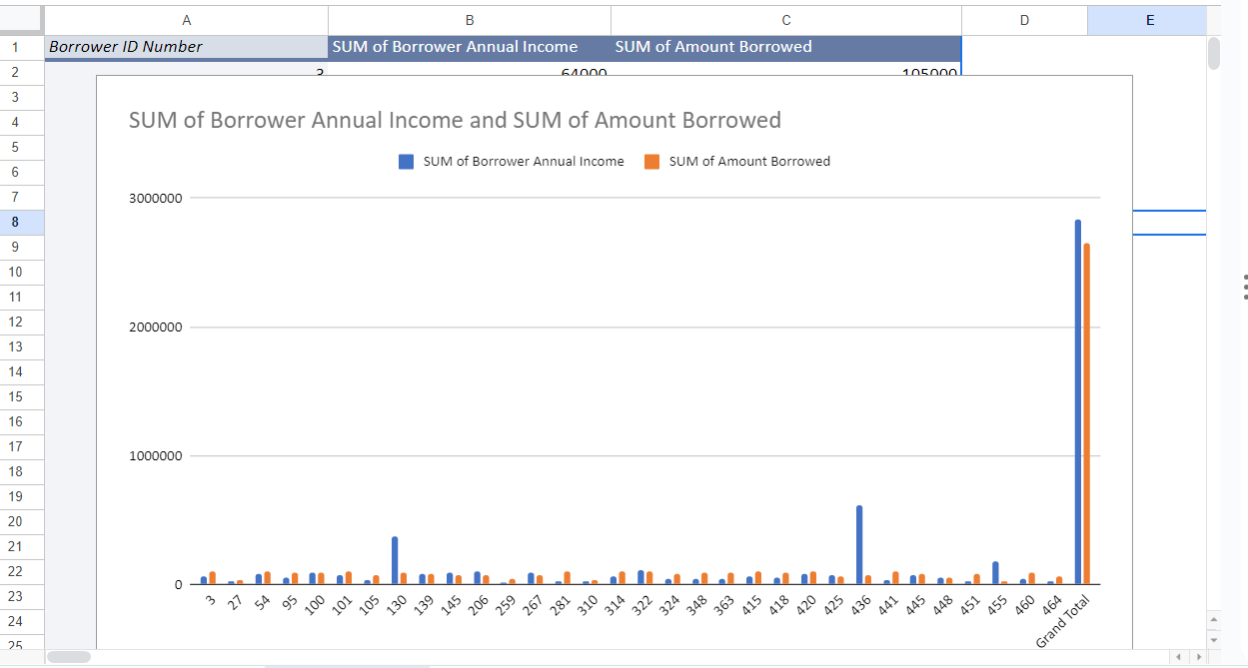

Slide 5
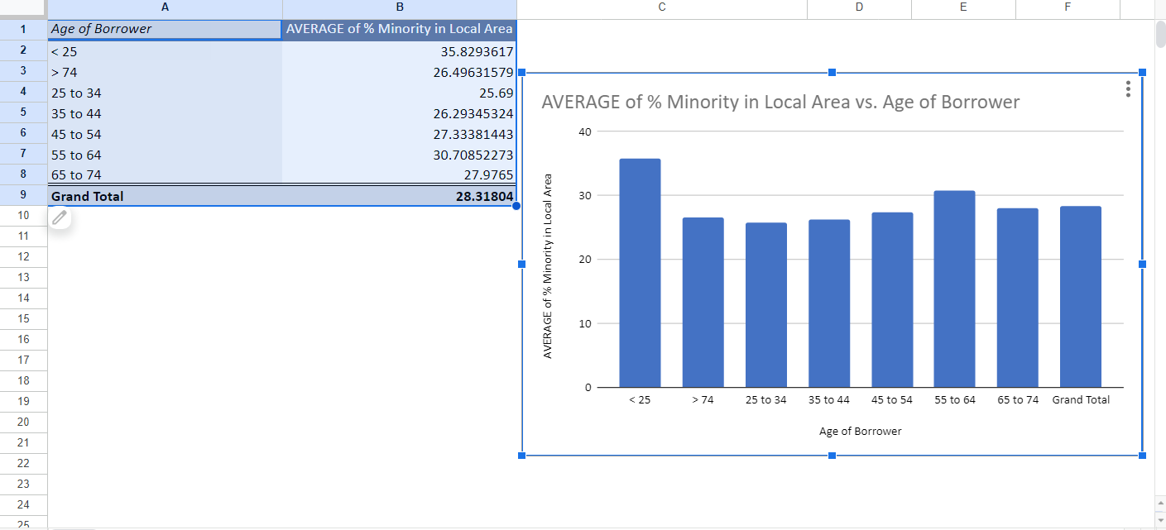

Slide 6
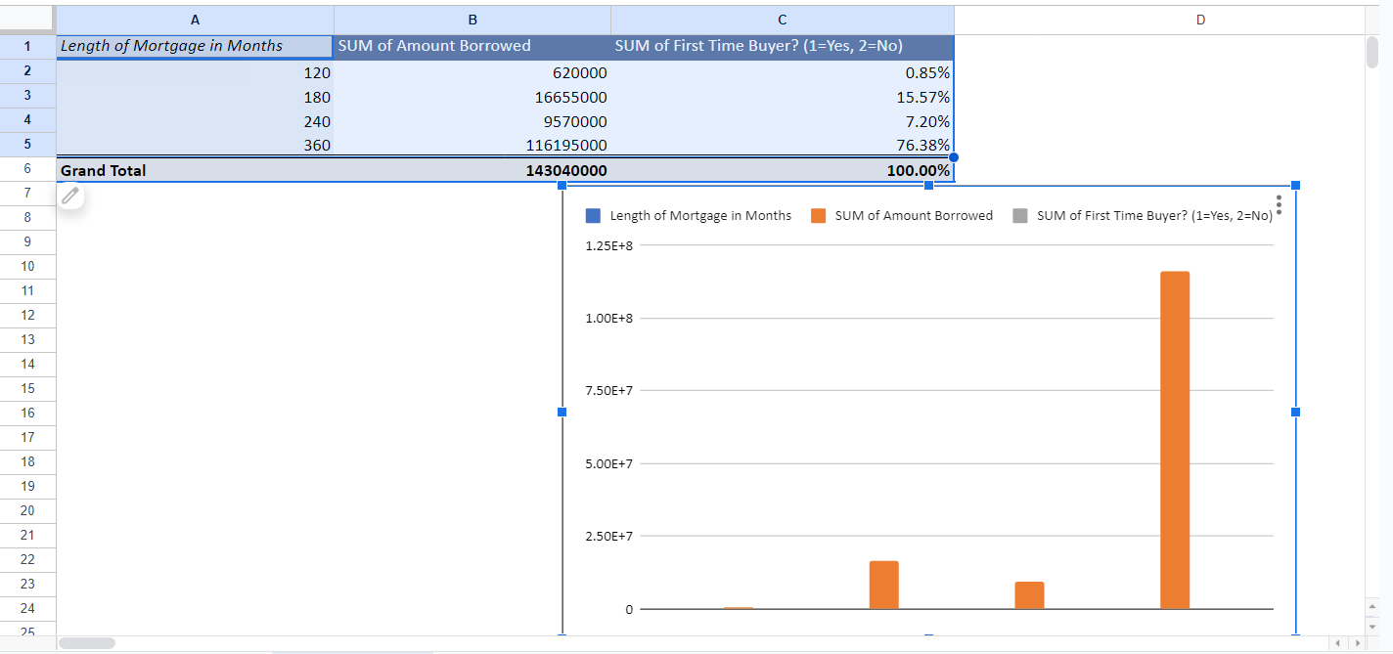

Slide 7
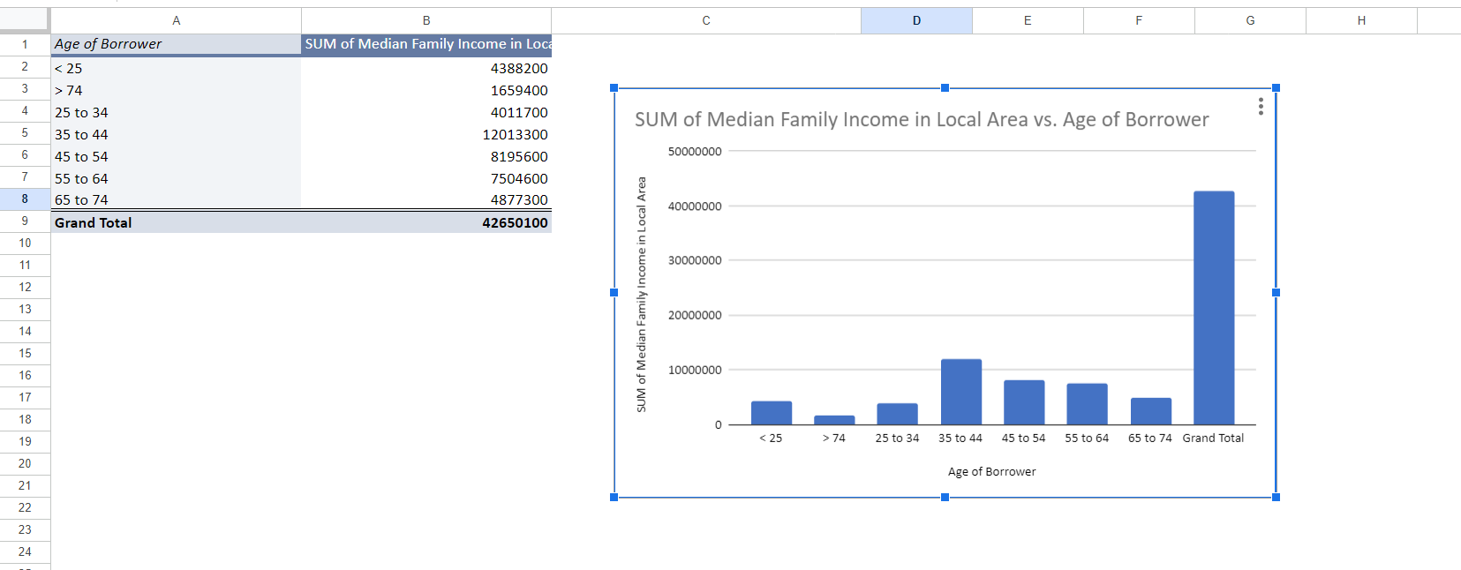

Slide 8
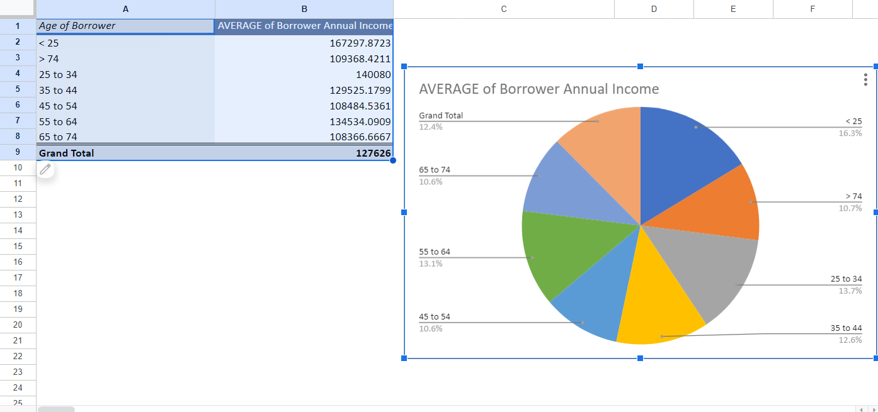

Slide 9
CONCLUSION
We can conclude from all the analysis that we have done is that multiple factors will lead to the amount of mortgage that a person can afford and the time it will take him to repay that loan. Also factors such as the minority % in the area is also considered because then those people will be liable to a few important benefits that are important to them.

